Slide 1

TCS Stock Data Analysis – Project Report
Data Analytics Internship Project Presentation
Prepared by Pratik Sagar|Data Analytics Intern

Slide 2

1
Project Overview
8
Daily Returns Analysis
Agenda
2
Dataset & Methodology
9
Predictive Modeling
TCS Stock Data Analysis Project
3
Data Preparation
10
Key Insights & Findings
4
EDA: Price Trend
11
Limitations & Future Scope
5
EDA: Trading Volume
12
Conclusion
6
EDA: Correlation Analysis
13
Q&A
7
Feature Engineering

Slide 3





Project Overview
This project focuses on the comprehensive analysis of Tata Consultancy Services (TCS) stock data. As a key constituent of Indian market indices, understanding TCS's historical performance provides valuable benchmarks for market volatility and long-term growth trends.
Analyze historical stock price behavior and identify meaningful patterns
Perform data cleaning, Exploratory Data Analysis (EDA), and validation
Engineer features and build a basic predictive model for closing prices

Slide 4








Dataset & Methodology
Overview of financial data attributes and the technical stack employed for analysis
Category
Component
Description & Usage
Dataset
Date & Time
Daily trading records parsed into datetime format for chronological analysis
Dataset
OHLC Prices
Open, High, Low, Close prices capturing daily market movements
Dataset
Volume & Events
Trading volume, plus corporate actions like Dividends and Stock Splits
Tools
Python Environment
Primary analysis environment using Jupyter Notebook / VS Code
Tools
Pandas & NumPy
Data cleaning, manipulation, and high-performance numerical operations
Tools
Matplotlib & Seaborn
Creation of static visualizations for trends, distributions, and correlations
Tools
Scikit-learn
Implementation of Linear Regression for predictive modeling

Slide 5

Date Parsing
Converted the Date column to standard
datetime format for accurate series analysis.
Chronological Sorting
Sorted the entire dataset by date to ensure
correct sequencing for trend identification.
Data
Preparation
Data Type Verification
Verified numerical integrity for Open, High,
Low, Close, and Volume columns.
Missing Value Check
Performed comprehensive scan for null values;
none were found, ensuring data reliability.

Slide 6

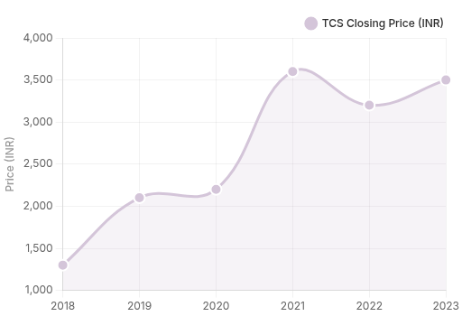


Stock Price Trend Analysis
The historical closing price analysis of TCS reveals a robust growth trajectory, demonstrating market resilience despite periodic economic fluctuations.
Strong Upward Trend: Consistent long-term value appreciation over the analyzed period.
Market Volatility: distinct periods of price fluctuation aligned with major market events.
Consistent Recovery: Rapid price rebounds observed immediately following downturns.

Slide 7
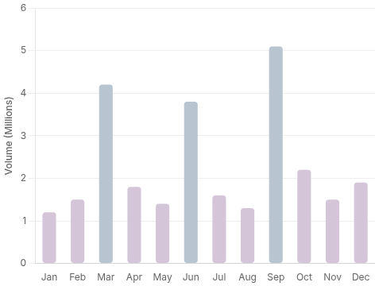


Trading Volume Analysis
An analysis of trading activity reveals distinct patterns in investor behavior and market participation.
Trading volume exhibits frequent spikes, particularly coinciding with periods of high market volatility.
Interestingly, high volume does not always correspond to sharp price changes, indicating absorption by large players.
Key Insight
This pattern strongly suggests institutional trading activity and significant long-term investor participation rather than purely speculative short-term trading.

Slide 8



Correlation Analysis
A statistical examination of the relationships between different market variables reveals key financial behaviors.
Open
High
Low
Close
Vol
Open
1.00
0.99
0.99
0.99
0.15
Price Synchrony: Open, High, Low, and Close prices exhibit near-perfect correlation, confirming strong intraday trend consistency.
High
0.99
1.00
0.99
0.99
0.18
Volume Independence: Trading volume shows weak correlation with price, indicating that high activity doesn't always dictate direction.
Low
0.99
0.99
1.00
0.99
0.12
Close
0.99
0.99
0.99
1.00
0.16
Corporate Actions: Dividends and stock splits show minimal short-term impact on price movements.
Vol
0.15
0.18
0.12
0.16
1.00
Analytic Insight
The strong multicollinearity among price variables is ideal for simple regression models but necessitates caution to avoid overfitting in complex ML algorithms.

Slide 9
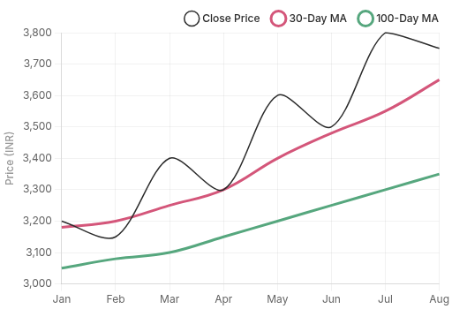



Feature Engineering: Moving Averages
To enhance predictive capability, we engineered moving average features. These indicators smooth out daily price noise to reveal the true underlying trend direction.
30-Day Moving Average: Captures short-term market sentiment and immediate trend shifts.
100-Day Moving Average: Identifies long-term structural trends and key support levels.
Momentum Signals: Crossovers between these lines provide early indicators of trend reversals.

Slide 10
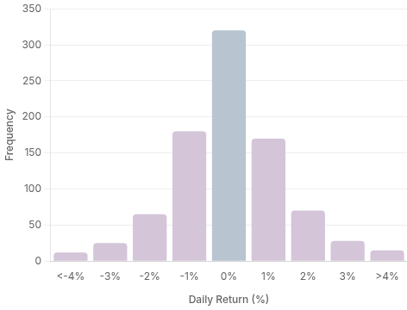


Daily Returns Analysis
Calculating the daily percentage change in closing price provides a clear picture of the stock's volatility profile and risk distribution.
The distribution is centered around zero, indicating that on most days, the stock price experiences only minor fluctuations.
However, the histogram reveals "fat tails"—instances of extreme positive or negative returns that signify market shocks.
Risk & Stability
While the central peak suggests general stability, the outliers highlight the presence of periodic high-volatility events that investors must account for in risk management.

Slide 11
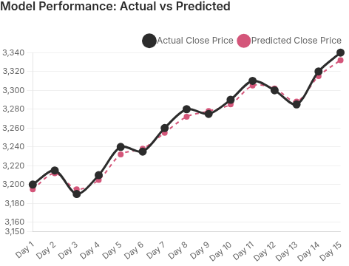


Predictive Modeling
We implemented a Linear Regression model to estimate TCS closing prices, utilizing the strong correlation between daily price metrics.
Model Features (Inputs)
Open Price, High Price, Low Price, Trading Volume
Target Variable
Close Price
Model Evaluation
R² Score: 0.99
High explanatory power
MSE: Low
Minimal prediction error

Slide 12




Key Insights & Findings
01
Strong Long-Term Growth: TCS stock demonstrates a consistent upward trend over the analyzed period, showing resilience and recovery after major market downturns.
02
Price Predictors: Open, High, and Low prices are highly correlated with the Closing price, making them strong predictors for linear regression modeling.
03
Volume Reliability: Trading volume shows weak correlation with price changes, indicating it is not a reliable standalone indicator for predicting immediate price movements.
04
Model Utility: While simple linear models can explain historical patterns with high accuracy (R²), they do not account for external market volatility or future uncertainty.

Slide 13







Limitations & Future Scope
Project constraints and potential avenues for extended analytical capabilities
Category
Focus Area
Description
Limitation
External Factors
Analysis excluded macro indicators, global market news, and sentiment data.
Limitation
Model Scope
Advanced time-series forecasting (e.g., ARIMA) was not explored in this phase.
Limitation
Applicability
Predictive models are for educational purposes, not real-time trading decisions.
Future Scope
Advanced AI
Implementation of ARIMA and LSTM networks for robust time-series forecasting.
Future Scope
Data Enrichment
Incorporation of external financial indicators, competitor data, and economic indices.
Future Scope
Dashboards
Development of interactive dashboards using Power BI or Tableau for stakeholders.
Future Scope
Risk Analysis
Deep dive into volatility metrics, Value at Risk (VaR), and drawdown analysis.

Slide 14

"This project successfully demonstrates a complete end-to-end data analytics workflow—encompassing data cleaning, advanced visualization, analytical thinking, and predictive modeling."

Slide 15
Thank You!
TCS Stock Data Analysis Project Report
I’m happy to walk through the Jupyter notebook and modeling details on request.

